Slide 1


HR Analytics Dashboard
Presented By
Student Name: Aditya Kumar Verma
College Name: SRM IST Delhi NCR Campus
Department: BTECH CSE (Data science)
Email : AV1753@srmist.edu.in

Slide 2
OUTLINE:
Problem Statement (Should not include solution)
Proposed System/Solution
System Development Approach (Technology Used)
Algorithm & Deployment
Result (Output Image)
Conclusion
Future Scope
References

Slide 3
Problem Statement:
Employee attrition is a major challenge for organizations as it affects
productivity, increases hiring costs, and impacts overall workforce stability.
Many organizations struggle to:
Identify patterns behind employee attrition
Understand factors such as salary, age, education, and job role affecting employee turnover
Make data-driven decisions for employee retention
Without proper analytics tools, HR departments find it difficult to analyze large employee datasets and identify the key reasons behind attrition.

Slide 4
Proposed Solution:
The proposed system is an HR Analytics Dashboard built using Power BI
to analyze employee attrition and workforce patterns.
The dashboard helps HR teams to:
Monitor employee attrition trends
Analyze employee data based on age, salary, education, and job roles
Identify departments or roles with higher attrition rates
Support data-driven HR decision making
The system transforms raw HR data into interactive visualizations for
better insights.

Slide 5
System Approach:
The project follows a data analytics approach using Power BI.
Technologies Used
Power BI Desktop – Data visualization and dashboard creation
Excel / HR Dataset – Data source
Power Query – Data cleaning and transformation
DAX (Data Analysis Expressions) – Calculations and measures
Development Steps
Data Collection
Data Cleaning and Transformation
Data Modeling
Dashboard Design
Visualization and Analysis

Slide 6
Algorithm & Deployment:
Although this project is mainly analytical, the following data analysis process is used:
Data Input
Employee dataset including:
Age
Salary
Job Role
Education
Years at Company
Attrition status
Data Processing
Data cleaning using Power Query
Calculating measures like attrition rate
Categorizing employees by salary slab, age group,
and department
Data Visualization
Power BI visual components used:
Bar charts
Pie charts
Line graphs
KPI cards
Tables

Slide 7
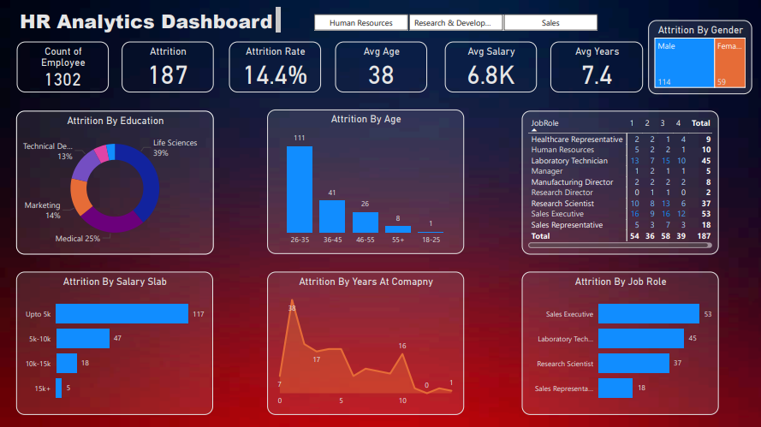
Result:

Slide 8
Conclusion:
Important findings from the analysis:
Highest attrition occurs in the 26–35 age group
Employees earning up to 5K salary show the highest attrition
Sales Executives and Laboratory Technicians have the highest turnover
Majority of attrition occurs within the first few years in the company
The HR Analytics Dashboard successfully analyzes employee attrition using Power BI.
The system helps organizations:
Understand employee turnover patterns
Identify departments with high attrition
Make better HR decisions based on data
This dashboard improves workforce management by providing clear and interactive visual
insights.

Slide 9
Future scope:
The system can be enhanced in the future by:
Integrating Machine Learning models to predict employee attrition
Connecting with real-time HR databases
Adding more HR metrics such as job satisfaction and performance scores
Deploying dashboards on Power BI Service for live monitoring

Slide 10
Thank You

Slide 11
References:
Microsoft Power BI
HR Analytics Dataset - https://drive.google.com/file/d/18G8LQsq-Bthr74LYhboH7d6sctPcnJdE/view?usp=sharing
Data Visualization best practices

